Slide 1


Academic Writing and Publishing
Resilient Urban Communities Consortium Conference Strathmore University, Nairobi, Kenya
Susan Appe, PhD, Associate Professor
Voluntas co-editor-in-chief
December 7, 2022

Slide 2
Official journal of ISTR, established in 1992
Editors: Fredrik O. Andersson, Susan Appe, Galia Chimiak
Book editor: Marc Jegers

Slide 3
Voluntas is an international and interdisciplinary journal that provides a central forum for worldwide research in the area between the state, market, and household sectors.
It is a leading academic outlet for research on the third sector, publishing on topics related to civil society, nonprofit organizations, social enterprise, volunteering, and philanthropy.
The journal publishes full-length articles and book reviews.

Slide 4
Voluntas In Numbers
In 2021: Voluntas received manuscripts submitted from 67 different countries, and accepted manuscripts from 33 (up from 25 in 2020)
1-Year Impact Factor 2.795 (2021)
5-Year Impact Factor 2.930 (2021)
2021: 467 submissions
73 days from submission to first decision
267 days from submission to acceptance

Slide 5
Disciplines and Fields of Submissions
Primary Discipline | Submissions
Sociology | 714
Management | 653
Public Administration | 481
Philanthropy | 440
Political Studies | 400
Economics | 285
Psychology | 218
Humanities | 126
Anthropology | 81
Education and Pedagogy | 69
Law and Legal Studies | 56
Other | 32
10/23/2021

Slide 6

Please Register to Review!
“Register Now”

Slide 7
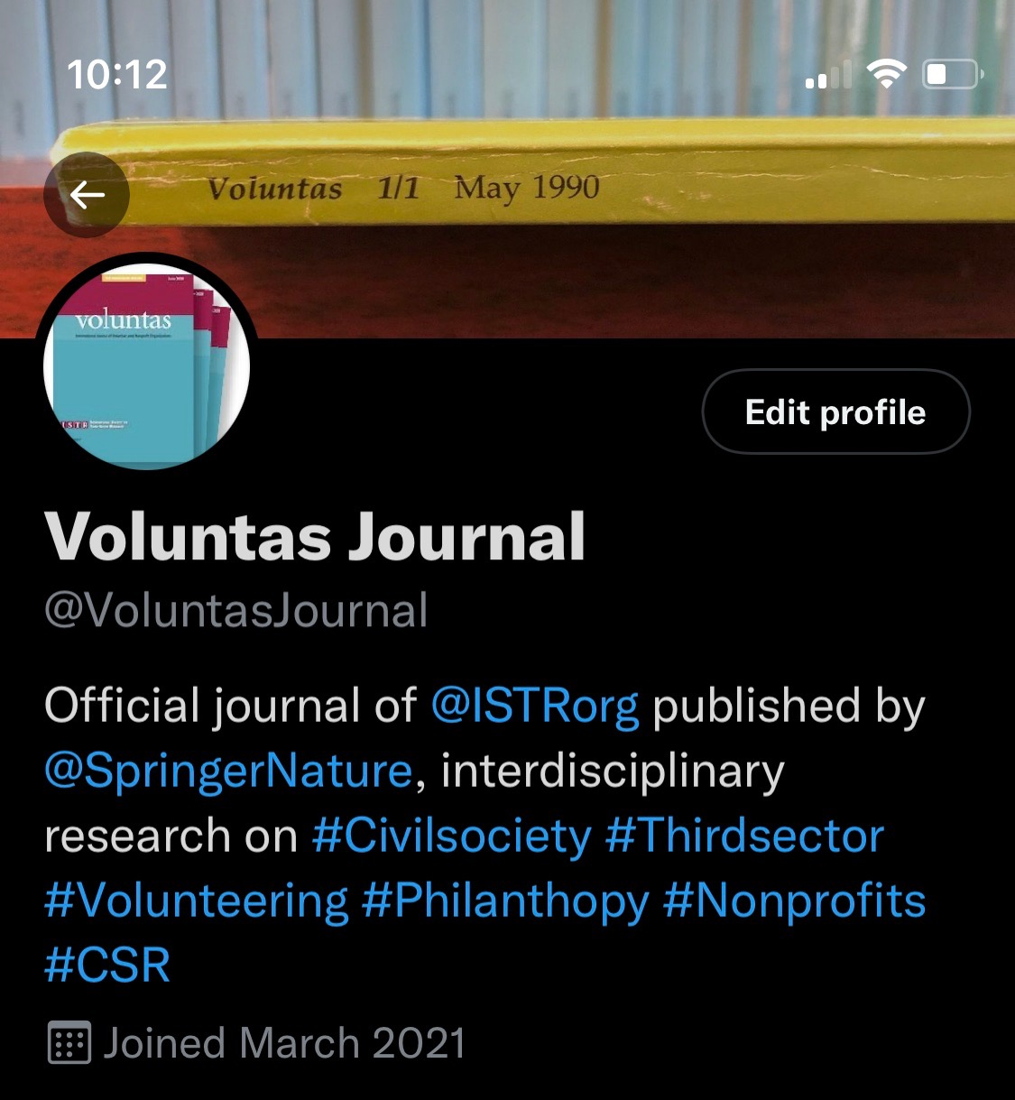

Join us: @VoluntasJournal
About 850 tweets since April 2021
Social Media Editor
  Marlene Walk, Indiana University - Purdue University, Indianapolis, USA

Slide 8
WHERE you can publish as a scholar/practitioner
Conference proceedings
Newspaper articles or editorials
Monographs or reports from funded research projects
Policy briefs
Book chapters
Peer-reviewed articles in academic journals
Books
Book reviews
Blogs
Questions:
Which items are most important for your institution?
Which items are most important for you?
Are some items a “waste of time”?
Which items are “easiest” for you?

Slide 9
WHERE you can publish as a scholar/practitioner
Conference proceedings
Newspaper articles or editorials
Monographs or reports from funded research projects
Policy briefs
Book chapters
Peer-reviewed articles in academic journals
Books
Book reviews
Blogs
Questions:
Which items are most important for your institution?
Which items are most important for you?
Are some items a “waste of time”?
Which items are “easiest” for you?

Slide 10
General Observations
Explain the state of the art and what you add to it
Go beyond description and use an explicit theoretical framework to analyse the issue you are discussing
Put in a clear and convincing section on methodology

Slide 11
Pieces of an Article: Title and Abstract
Title – Self-explanatory instead of overly creative
Abstract
    Gives the first impression!
    Abstract needs to match precisely the content and argument of your paper

Slide 12
Pieces of an Article: Opening Parts
An article requires a clear and logical progression of an argument
Introduction
    Big picture, present perhaps a gap/puzzle in knowledge
Literature review (~2—3 pages)
    What does literature tell about RQ & research gap/puzzle (and why we should know more about it – the SO WHAT?)

Slide 13
Pieces of an Article: Theoretical Contribution
Literature Review & Theory
  Define your terms
  Use an explicit theoretical framework
  Draw on relevant literature! (especially from the journal and field!)

Slide 14
Pieces of an Article: Approach and Methodological Rigor
Describe your method and/or approach in detail.
If empirical, dedicate a solid section on methods that explains the methodological approach
  methodological approach
  data collection (including inclusion and exclusion criteria)
  data analysis (at times, this needs to be explained step by step)
  positionality and limitations as appropriate

Slide 15
Pieces of an Article: The So What?
Presentation of results and findings
  Must emerge from data
Discussion
  Connect findings to theory and state of the art
  What is new, what confirms/contradicts findings of others?
  What is/are missing/limits of your study?

Slide 16
Research Approach/Paper Outline
WHAT you did | purpose of the research (introduction)
WHY you did it | problem/puzzle of the research (intro/literature review)
HOW you did it | how the problem was studied (methods)
WHAT you found | the principal findings (results)
WHAT it means | what the findings mean and why is this important (discussion and conclusion)

Slide 17
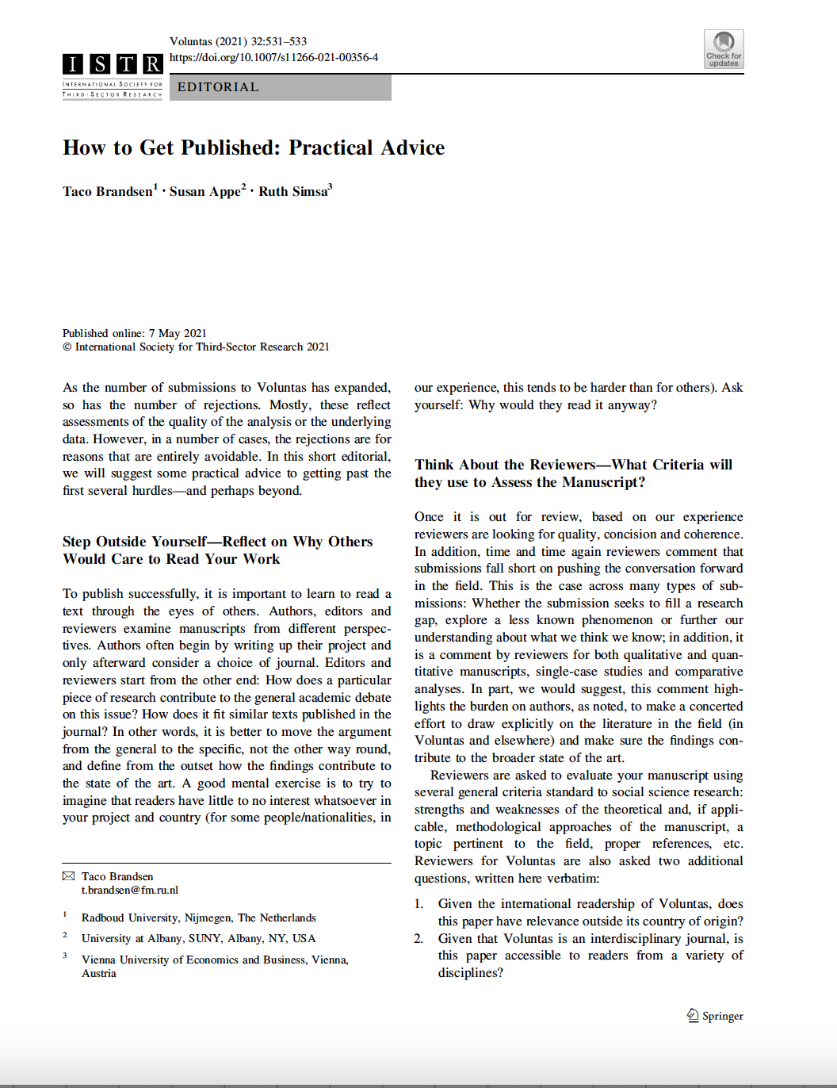
Key Takeaways
Go from general to specific!
Explain what general debate you are part of and why research in your specific region/case is interesting for an international audience

Slide 18


ISTR PhD Seminar Alumni Quarterly Newsletter
Introducing ISTR PhD alumni’s
very own newsletter!
Stay updated with what’s happening in ISTR and the ISTR PhD seminar alumni network.
Be featured in our newsletter columns or contribute content.
Meet fellow alumni and find out about their cutting-edge research and their career pathways.
Learn about finding a role in academia or the third sector in your part of the world.
Gain perspectives on researching the third sector and get advice on writing and completing your thesis.
Find collaborators for your project and share calls for funding, applications, papers, and seminars.
Help us tailor the newsletter’s content
to your needs and interests!
Take our online survey if you’re
an ISTR PhD seminar alumnus
(from whichever year)!
https://bit.ly/PhDAlumniSurvey2022

Slide 19


ISTR PhD Seminar Alumni Quarterly Newsletter
“I would like to
be interviewed.”
“I would like to
contribute content.”

Slide 20

Publication Hierarchy
Be aware of predatory journals:
See: https://www.nature.com/articles/d41586-019-03759-y

Slide 21
Publication Hierarchy
Be aware of predatory journals: https://predatoryjournals.com/journals
There is also a movement towards “open access” journals
Journal rankings are frustrating for interdisciplinary scholars who are publishing in multiple fields
Publishing in higher-tier journals improves your record… But there are tradeoffs between getting the “perfect” publication vs getting “some” publications

